Slide 1

5: Web Mining
152.152.98.11 - - [16/Nov/2005:16:32:50 -0500] "GET /jobs/ HTTP/1.1" 200 15140 "http://www.google.com/search?q=salary+for+data+mining&hl=en&lr=&start=10&sa=N" "Mozilla/4.0 (compatible; MSIE 6.0; Windows NT 5.1; SV1; .NET CLR 1.1.4322)“
252.113.176.247 - - [16/Feb/2006:00:06:00 -0500] "GET / HTTP/1.1" 200 12453 "http://www.yisou.com/search?p=data+mining&source=toolbar_yassist_button&pid=400740_1006" "Mozilla/4.0 (compatible; MSIE 6.0; Windows NT 5.1; SV1; MyIE2)"
252.113.176.247 - - [16/Feb/2006:00:06:00 -0500] "GET /kdr.css HTTP/1.1" 200 145 "http://www.kdnuggets.com/" "Mozilla/4.0 (compatible; MSIE 6.0; Windows NT 5.1; SV1; MyIE2)"
252.113.176.247 - - [16/Feb/2006:00:06:00 -0500] "GET /images/KDnuggets_logo.gif HTTP/1.1" 200 784 "http://www.kdnuggets.com/" "Mozilla/4.0 (compatible; MSIE 6.0; Windows NT 5.1; SV1; MyIE2)"
Behavior Analysis
152.152.98.11 - - [16/Nov/2005:16:32:50 -0500] "GET /jobs/ HTTP/1.1" 200 15140 "http://www.google.com/search?q=salary+for+data+mining&hl=en&lr=&start=10&sa=N" "Mozilla/4.0 (compatible; MSIE 6.0; Windows NT 5.1; SV1; .NET CLR 1.1.4322)“
252.113.176.247 - - [16/Feb/2006:00:06:00 -0500] "GET / HTTP/1.1" 200 12453 "http://www.yisou.com/search?p=data+mining&source=toolbar_yassist_button&pid=400740_1006" "Mozilla/4.0 (compatible; MSIE 6.0; Windows NT 5.1; SV1; MyIE2)"
252.113.176.247 - - [16/Feb/2006:00:06:00 -0500] "GET /kdr.css HTTP/1.1" 200 145 "http://www.kdnuggets.com/" "Mozilla/4.0 (compatible; MSIE 6.0; Windows NT 5.1; SV1; MyIE2)"
252.113.176.247 - - [16/Feb/2006:00:06:00 -0500] "GET /images/KDnuggets_logo.gif HTTP/1.1" 200 784 "http://www.kdnuggets.com/" "Mozilla/4.0 (compatible; MSIE 6.0; Windows NT 5.1; SV1; MyIE2)"

Slide 2
Web Log Analysis
Behavior analysis
builds on top of all
previous levels
Behavior
Visits
Pages
HITS

Slide 3
Web Usage Mining – Goals
Classification is only one type of analysis
Typical eCommerce Goals:
  Improve conversion from visitor to customer
    multiple steps, e.g.
    Identify factors that lead to a purchase
  Identify effective ads (ad clicks)
  Branding (increasing recognition and improving brand image)
  …
most Goals can be stated in terms of Target Pages

Slide 4


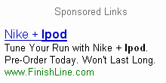
Target pages (actions)
For e-commerce site –
  Add to Shopping Cart
  Buy now with 1-click
For ad-supported site –
  Ad click-thru on a gif or text ad

Slide 5
Behavioral Model
Behavioral model can help to predict which visitors
Hit-level analysis is insufficient
Related hits should be combined into a visit
  Combine related requests into a visit
  Analyze visits
  Extract features from visit sequence

Slide 6
Extracting Features From Visit
Sequence
Possible visit features
Total number of hits
Number of GETS with OK status (200 or 304)
Number of Primary (HTML) pages
Number of component pages

Slide 7
Extracting Features, 2
More visit features
Visit start
Visit duration (time between first and last HTML pages)
Speed (avg time between primary pages)
Referrer
  direct, internal, search engine, external

Slide 8
Extracting Features, 3
User agent – main features
Browser type:
  Internet Explorer, Firefox, Netscape, Safari, Opera, other
    Browser major version
  OS: Windows (98, 2000, XP, ), Linux, Mac, …

Slide 9
IP Address - Region
IP address can be mapped to host name
  typically 15-30% of IP addresses are unresolved
Host name TLD (last part of host name) can be mapped to a country and a region (see module 3a)
Example: .uk is in UK, .cn is in China
Full list at www.iana.org/cctld/cctld-whois.htm

Slide 10
IP Address – Region, 2
Beware that not all .com and .net are in US
Example:
  hknet.com is in Hong Kong
  telstra.net is in Australia
Also, not all aol.com subscribers are in Virginia – they can be anywhere in the US

Slide 11
IP Address Geolocation
Advanced: Geolocation by IP address
  not perfect (can be fooled by proxy servers), but useful
Useful sites
  www.ip2location.com/
  www.dnsstuff.com/info/geolocation.htm
IP2location commercial DB will map IP to location
This info changes frequently – Google for "geolocation" for latest

Slide 12
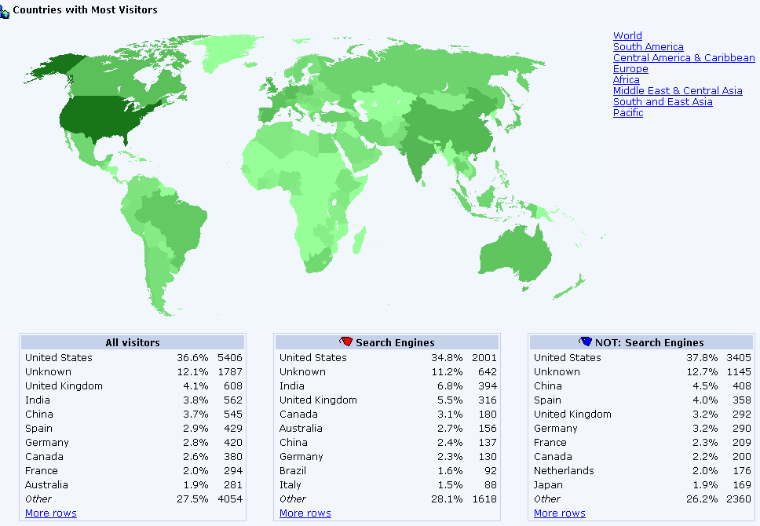
ClickTracks: Country Report
For KDnuggets, week of May 21-27, 2006 (partial data)

Slide 13
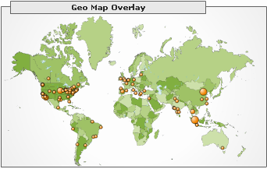
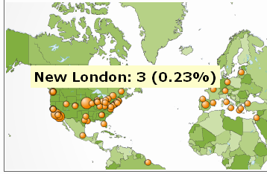
Google Analytics Geolocation Report
Global map and city-level detail

Slide 14
*Host Organization Type
Another useful classification is
Host Organization Type.
  Business, e.g. spss.com
  Educational/Academic, e.g. conncoll.edu
  ISP – Internet Service Provider, e.g. verizon.net
  Other: government/military, non-profit, etc

Slide 15
*Host Organization Type: TLD
For generic TLD,
.com : usually Business
  there are exceptions
.edu : Educational (.edu)
.net : ISP
.gov (government), .org (non-profit) can be grouped into other

Slide 16
*Host Organization Type, ccTLD
More complex for country level TLD
E.g. for UK,
  .co.uk is business
    except for some ISP providers, like blueyonder.co.uk
  .ac.uk is educational
Patterns differ for each country
A useful database can be constructed
Time consuming but very useful for understanding the visitors

Slide 17
For BOT or NOT classification
The visitor is likely a bot if
User agent include a known bot string
  e.g. Googlebot, Yahoo! Slurp, msnbot, psbot
  crawler, spider
  also libwww-perl, Java/, …
or robots.txt file requested
or no components requested

Slide 18
Bot or Not, 2
More advanced rules
bot trap file (defined in module 4a) requested
Accessing primary HTML pages too fast (less than 1 second per page for 3 or more pages)
Additional rules possible

Slide 19
For building a click-thru model
Model may be very simple – almost all work is in data collection
Ad type/size
Graphic and or Text
Section of the website

Slide 20
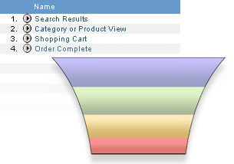
For building e-commerce model
Typical e-commerce conversion funnel
  Search
  Product View
  Shopping Cart
  Order Complete
Graphic thanks to WebSideStory

Slide 21
Micro-conversions
Micro-conversions – from each level of the funnel to the next level
Each micro-conversion may require a separate model.

Slide 22
Modeling Visitor Behavior
Bulk of work is in data preparation
Even simple reports are likely to be useful
More complex models are good for personalization

Slide 23
Additional non-web data
Behavior
Additional customer data
is very useful,
when available
Additional data
Visits
Pages
HITS

Slide 24
Modeling visitor behavior: applications
Improve e-commerce
  right offer to the right person
  Recommendations
  Amazon: If you browse X, you may like Y
Targeted ads
Fraud detection
…

Slide 25
Summary
Web content mining
Web usage mining
  Web log structure
  Human / Bot / ? Distinction
  Request and Visit level analysis
Beware of exceptions and focus on main goals
Improve conversion by modeling behavior

Slide 26
Additional tools for Web log analysis
Perl for web log analysis
  www.oreilly.com/catalog/perlwsmng/chapter/ch08.html
Some web log analysis tools
Analog www.analog.cx/
AWstats awstats.sourceforge.net/
Webalizer www.mrunix.net/webalizer/
FTPweblog
www.nihongo.org/snowhare/utilities/ftpweblog/

Slide 27
Some Additional Resources
Web usage mining
  www.kdnuggets.com/software/web-mining.html
Web content mining
www.cs.uic.edu/~liub/WebContentMining.html
Data mining
www.kdnuggets.com/

